Slide 1



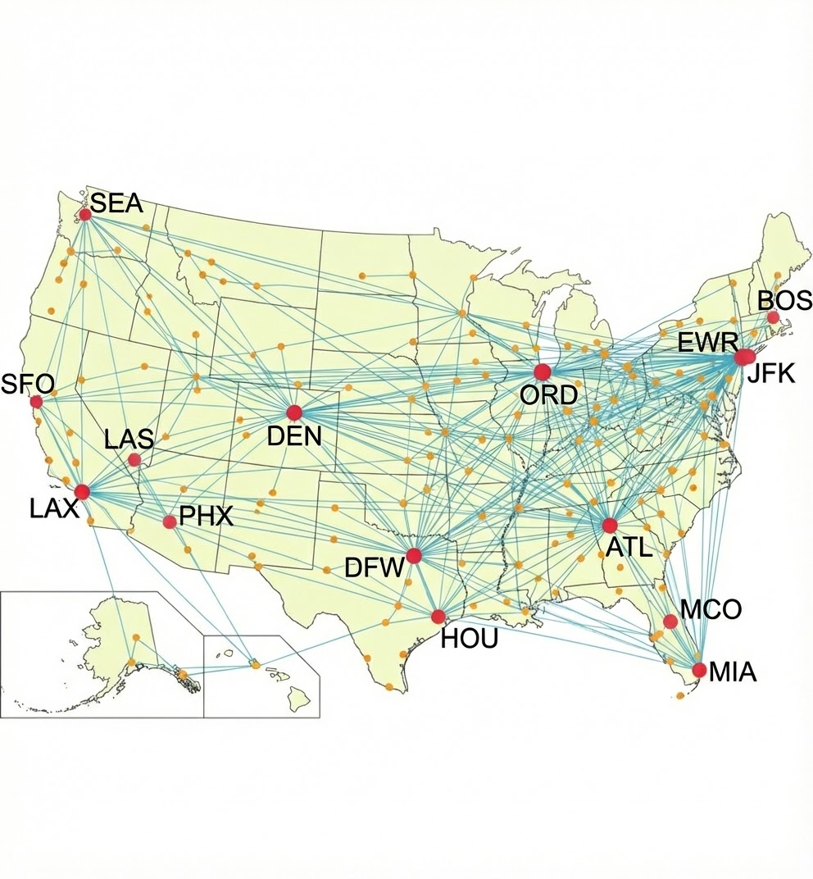
Operational Resilience: Identifying Pilot Sequence Disruptions
Jennifer Zhang, Gilla Wu, Rebecca Shih, Pranav Piedy, Nuoci Ding
Why Flight Pairing Matters?
Delays don’t stay isolated — they spread
Pilot sequences connect multiple flights
Weather risk varies by airport and season
High-risk inbound + outbound = fragile schedule

Slide 2












Key Data Sources
BTS Data On-Time Performance
FAA ASPM Performance Metrics
Weather AWC / NOAA
Internal Staffing Pilot Schedules
WHAT IT PROVIDES
WHAT IT PROVIDES
WHAT IT PROVIDES
WHAT IT PROVIDES
• Arrival and departure delays. • By route, airport, and time/date.
• Flight schedules/delays. • Airport, city-pair (route) and taxi time.
• METAR, TAF. • Historical seasonal and weather patterns.
• Existing sequences, pilot times, rules, crew base.
HOW WE USE IT
HOW WE USE IT
HOW WE USE IT
HOW WE USE IT
• Turn buffer • Arrival variability
• Congestion patterns • Congestion vs. delays relationship
• Identify seasonal trends • Predict volatility
• Calculate duty length • Check limit violations
IMPORTANCE
IMPORTANCE
IMPORTANCE
IMPORTANCE
Foundation of pilot sequencing. Identifies tight connections & unpredictable inbound flights.
Congestion increases delay risk. We avoid pairings passing through peak congestion.
Volatile weather causes disruption. We avoid pairings with simultaneous weather risks.
Accounts for operational & fatigue risk using strict airline-specific scheduling rules.
Together, these sources help us with relevant data to model and penalize high-risk flight pairings.

Slide 3





Feature Engineering:
Decoding Sequence Vulnerability
From single-flight metrics → sequence fragility
1. Node Risk — Individual Airports
2. Edge Risk — Pairwise Connection
3. Hub Buffer — DFW Context
•
Seasonal weather sensitivity (impact differs by season)
•
Delay amplification (30 min → 60min)
Weather correlation (shared storm systems)
Seasonal co-risk (both risky at once)
•
Turnaround slack
•
•
Peak bank window
•
Same weather ≠ same delay (airport-specific response)
•
Congestion multiplier
•
•
Arrival vs. departure recovery (how fast delays clear)

Slide 4

















Model Approach
LAYER 1: DATA INGESTION
Historical Flight Data (Latency Patterns)
Real-Time Weather (Sparse Event Data)
Crew Rules (Union/FAA)
Operational Constraints (Aircraft/Gate)
LAYER 2: INTELLIGENCE ENGINE
Model A: Spatio-Temporal GNN
Model B: XGBoost Classifier
LAYER 3: SOLVER (SIP CORE)
Combined Risk Probabilities & Network Embeddings
HARD CONSTRAINTS
SOFT OBJECTIVES
▪
Union CBA & FAA Legalities
Minimize Premium Pay & Deadhead Costs
▪
Aircraft Type-Rating Compatibility
SIP ENGINE
▪
▪
Minimum Connection Times (MCT)
▪
Maximize Sequence Robustness Score
▪
▪
Base Return Requirements
Optimize Crew Quality of Life (QoL) Metrics
LAYER 4: EXECUTION INTERFACES
Optimized Rosters Push via API
Disruption-Ready Reserves Strategic Buffer Allocation
Live Manager Dashboard Real-time KPI Monitoring

Slide 5


Evaluation: Measuring Real Operational Impact
Key Success Metrics
Why Accuracy Is Not Enough
Ranking Quality - Precision @ K
Are the “top ranked flight pairs” the one’s that actually break the schedule?
Severe disruptions are rare but extremely costly. A model could be 99% accurate by simply predicting "no delay" every time.
System Impact - Reduction in Downstream Delay
Missing a few critical cases causes most of the damage. We must prioritize catching the failures.
Do delays stop propagating along legs?
Success means preventing the few failures that cause the most disruption.
Operational Failure
Missed connection rate
Crew Duty Risk Proxies
Tight turnaround failures

Slide 6






From Risk Scores to Scheduling Decisions
Deployment Philosophy
How the Output Is Used
Business Impact
•
Decision support, not automation
•
Fewer cascading delays
Option 1: Do-Not-Pair List Hard exclusions for consistently high-risk flight pairings
•
Does not replace crew scheduling systems
•
Lower recovery costs
•
More resilient schedules under stress
Option 2: Penalty-Based Optimization Risk scores enter crew pairing as soft costs

Slide 7
Thank You

